Slide 1
A sight To See
By: Joshua Amora

Slide 2
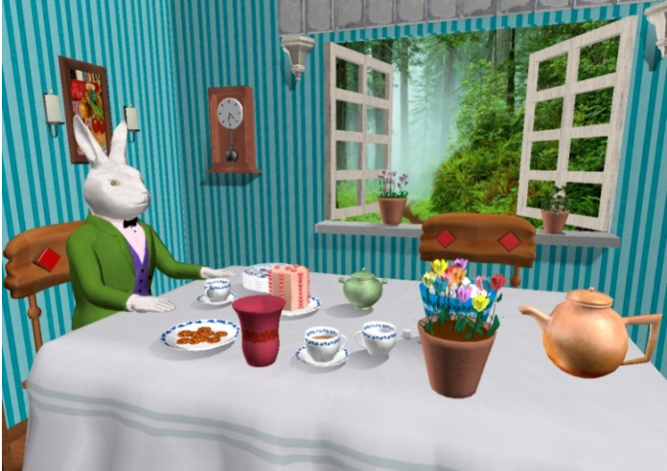

Slide 3
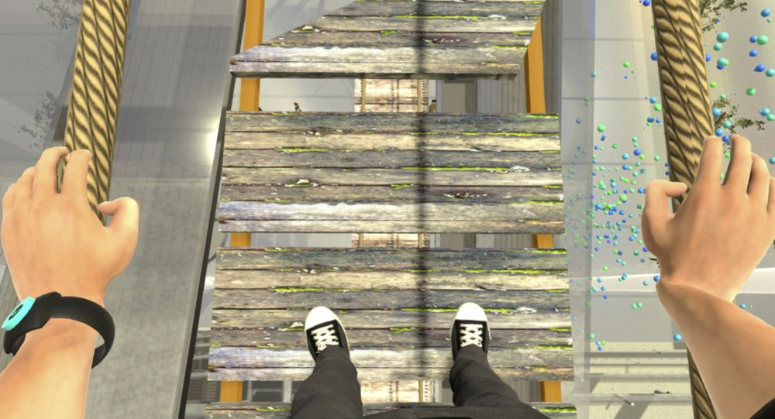
Advantanges
Controllable
Easier exposure
Distraction

Slide 4
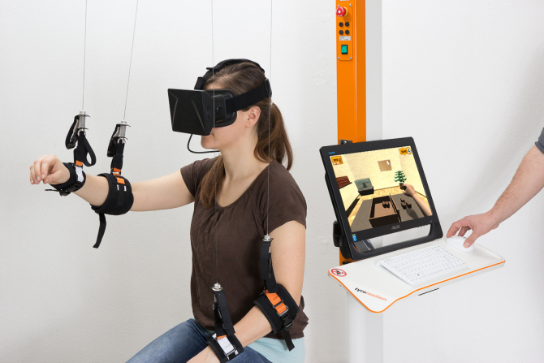
Disadvantages
Expensive
Difficult to Set up
Unstable Software

Slide 5
Effectiveness
Phobia
Flight
Spiders
Social Anxiety
Public Speaking
Common Human Interaction

Slide 6
Future Research
Therapeutic Stories
Research in negative effects
Virtual embodiment

Slide 7
Conclusion
Technology is:
Evolving
Multi-purpose
Helpful

